Slide 1
Medicare changes for the coming year
Notes:
Hello and thank you for being here and welcome to the 2027 Medicare changes presentation. As you will hear, there are quite a number of changes for 2027. So, let’s get started!

Slide 2
What changes each year?
Medicare Open Enrollment happens every year from October 15 - December 7. This is the time when you should review your current Medicare Advantage and Part D plans and compare it with other plans.
Medicare plans can change what they cover every year, such as whether your providers or drugs are covered, so it’s important to review your options to make sure you are covered.
There can also be big changes, such as plans no longer being offered where you live.
Also, your medical needs may have changed. Maybe you have a new diagnosis or are taking different medication or seeing a new medical provider.
Notes:
There are many changes this year. During this year’s open enrollment, you will notice that there are many plan changes.
Providers are changing.
Costs are changing
Pharmacy networks are changing and formularies are changing
Your plan may have all these changes, only a few or none. Everyone’s situation and options may be different.

Slide 3
Medicare costs that can change
Part A (hospital insurance): The inpatient hospital deductible and other cost-sharing amounts may change.
Part B (medical insurance): The monthly premium, annual deductible and other cost-sharing amounts may change.
Part D (prescription drug coverage): Premiums, deductibles, copayments and other plan costs may change.
Medicare health plans (Advantage and Cost Plans): Premiums, copayments, deductibles, out-of-pocket limits and extra benefits may change.
Medigap: Premiums can change, even outside of the Medicare Open Enrollment Period.
Notes:
Part A: Costs change annually. Part A is part of Original Medicare and covers inpatient hospital care and some other services.
Part B: Costs change annually. Part B is part of Original Medicare and covers doctor visits, outpatient care and other medical services.
Part C (Medicare Advantage): Plan costs and benefits can change annually. The plan provides Medicare-covered services instead of Original Medicare. Some plans offer a point-of-service option that lets members see out-of-network providers at a higher cost.
Part D: Prescription drug coverage costs and benefits can change annually.
Medicare Cost Plans: These plans have provider networks but also allow members to use Original Medicare for covered services outside the network. They are different from Medicare Advantage plans.
Medigap policies: Private insurance companies sell these policies to help pay some of the costs that Original Medicare does not cover. Standardized Medigap plans of the same type offer the same basic benefits. Medigap policies generally do not have provider networks. They do not cover outpatient prescription drugs under Part D but may cover certain drugs administered in a medical setting under Part B.

Slide 4
Coverage and benefits that can change
You should not assume your doctors, prescriptions or costs will remain the same.
Medicare Advantage plans may change their covered services, extra benefits and cost-sharing rules.
Prescription drug plans may change their formularies, which are lists of covered medications.
Plans may add or remove benefits, providers, hospitals and pharmacies from their networks.
Prior authorization requirements and other coverage rules may change.
Notes:
Every year, coverage or benefits can change. There may be a new benefit covered, or existing benefits may end.

Slide 5
Plan availability can change
Insurance companies may stop offering certain plans.
New this year — Insurance companies may limit, or cap, the number of people who can enroll in a specific plan.
Plans may leave the entire state or specific counties while continuing to be offered in others.
  People may need to choose a new plan if their current plan ends or no longer serves their county.
Plans may enter new counties or offer different products.
Notes:
A little further on, we’ll share how insurance companies leaving will impact people in Minnesota.
A major change this year is that Medicare Advantage plans can choose to place caps on their plans which limit the number of enrollments into a plan. Advantage plan cap numbers will be shown in Medicare Plan Finder details for those plans with caps.

Slide 6
Medicare rules and enrollment options can change
Federal Medicare rules, cost limits and enrollment options may change.
There are programs to help people with limited income and resources, and these programs can have changes to eligibility requirements.
Special enrollment periods may become available to people who meet certain conditions.
Minnesota law may change the circumstances in which people can enroll in or switch Medigap policies.
Notes:
There are options known as Special Enrollment Periods (SEPs) for people who meet specific criteria, such as their plan left their county of residence or the state.
There are many SEPS available (more than 15) for different reasons.

Slide 7
Nationwide Medicare changes for 2027
Updates to Medicare Plan Finder
Expanded Medicare coverage
Updated premiums, deductibles, copays and maximum out-of-pocket costs
Income and asset eligibility amounts for Medicare Savings Programs and Extra Help for Part D
Notes:
In this section, we’ll cover changes that will affect people on Medicare nationwide, include specific changes to premiums, deductibles, copays and maximum out-of-pocket costs. We’ll also discuss income and asset eligibility for programs that are available to help people pay for Medicare Part A, B and D costs, Medicare Savings Programs and Part D Low Income Subsidy.

Slide 8
Medicare Plan Finder updates
Medicare added more secure options for you to log into your Medicare.gov account including, ID.me, CLEARme.com and Login.gov. They made these changes to help prevent fraud and keep your health information secure.
Medicare.gov was updated to make it easier for you to find more plan information in the Plan Finder, such as:
  More in-depth details about preventive services
  Direct links to plan documents on insurance company websites, such as formularies and Summaries of Benefits
  Clear, prominent alerts about changes impacting your current plans in 2027
Notes:
2027 Medicare Plan Finder changes include:
Star ratings overhaul —Plan Finder will display a narrower, more clinically focused rating set
Part D benefit redesign reflected in plan comparisons
Elimination of the Part D coverage gap (donut hole).
Lower annual out‑of‑pocket threshold and no cost‑sharing in the catastrophic phase.
These benefit changes will be reflected in Plan Finder’s cost estimates.
Supplemental benefit clarifications
Plan Finder will incorporate updated rules for supplemental benefits:
Debit cards for supplemental benefits must be electronically linked to eligible items in real time and limited to the plan year.

Slide 9
Expanded Medicare coverage
Medicare now provides more access to certain GLP-1 drugs with the Medicare GLP-1 Bridge program. These drugs help people lose weight and improve their health.
Medicare now covers the Medicare Diabetes Prevention Program.
Medicare offers ACCESS, a way to get care that supports people with Original Medicare who have one or more chronic health conditions.
In 2027 you can get telehealth services at any location in the U.S.
Notes:
Every year, coverage or benefits can change. There may be a new benefit covered, or existing benefits may end. Some new benefits for 2027 include:
Expanded telehealth but it ends on 12/31/2027
ACCESS model - A new care model for people with Original Medicare who have chronic conditions (diabetes, hypertension, depression, etc.). Offers virtual visits, wearable devices, lifestyle coaching, and coordinated care. May be available at low or no cost.
Medicare Diabetes Prevention Program now includes virtual-only providers, live sessions, and self‑paced options.
Launch of the Rural Health Transformation Program to strengthen rural facilities, upgrade technology, and expand access.
Medicare Advantage plans may process prior authorizations electronically. People may view decisions directly in their patient portal.

Slide 10
Expanded Medicare coverage (cont.)
Medicare is negotiating with participating drug companies over the price of certain expensive brand-name Part B and Part D drugs that don’t have competition.
  Prices for the first 10 Part D drugs that Medicare negotiated became available in 2026.
  The lower price for the next 15 drugs will take effect on January 1, 2027.
Some companies will limit the number of people who can enroll in certain Medicare Advantage plans, also called enrollment capacity limits or caps.
  Once a plan reaches its government-approved limit, it will close to new enrollments.
Notes:
New drugs with negotiated prices for 2027
Austedo / Austedo XR
Breo Ellipta
Calquence
Ibrance
Janumet / Janumet XR
Linzess
Ofev
Otezla / Otezla XR
Ozempic / Rybelsus / Wegovy
Pomalyst
Tradjenta
Trelegy Ellipta
Vraylar
Xifaxan
Xtandi

Slide 11
2026 Income-related Adjustment Amounts (IRMAA)
Single tax filing status 2024 income | Joint tax filing status 2024 income | 2026 Part B premium | 2026 Part D premium
Equal to or less than $109,000 | Equal to or less than $218,000 | $202.90 (Standard) | Plan premium
$109,001-$137,000 | $218,001- $274,000 | $284.10 | Plan premium + $14.50
$137,001- $171,000 | $274,001- $342,000 | $405.80 | Plan premium + $37.50
$171,001 - $205,000 | $342,001 - $410,000 | $527.50 | Plan premium + $60.40
$205,001 - $499,999 | $410,000 - $749,999 | $649.20 | Plan premium + $83.30
Equal to or more than $500,000 | Equal to or more than $750,000 | $689.90 | Plan premium + $91.00
Notes:
The amounts for 2027 have not been released yet.
The IRMAA requires people with higher incomes to pay higher Medicare Part B and Part D monthly premiums.
People can appeal the IRMAAA if they disagree with the decision.

Slide 12
Part D drug coverage changes
 | 2027
Base beneficiary national premium | $41.33 (6% increase which is the maximum allowed by law)
Maximum out-of-pocket costs (MOOP) | $2,400 ($2,100 in 2026)
Deductible | $700 ($615 in 2026)
Minnesota base premium benchmark amount | $24.60
Co-pay amounts | Up to 100% of FPL Generic: $1.65 Brand name: $5.00 100% - 150% of FPL Generic: $5.80 Brand name: $14.40
Notes:
2027 Medicare Part D Coverage information

Slide 13
Part D drug coverage phases
 | 2027
Deductible phase | Cost sharing: 100%
 | Deductible: $700 (not all plans have deductibles)
Initial coverage phase | Covered drugs Cost sharing: 25% (Bene pays) Plan pays: 65% Discount: 10%
 | Initial coverage limit: N/A
Catastrophic phase | Covered drugs (after $2,400 is reached) Plan pays: 60% Discount: 20% Reinsurance: 20%
Notes:
2027 Coverage phases for 2027

Slide 14
Medicare Savings Programs eligibility
Medicare Savings Programs | Benefit | Financial eligibility 2026-2027 (single/couple)
 |  | Monthly income | Resources
Qualified Medicare Beneficiary (QMB) | Part A & B premiums, deductibles, cost-sharing | $1,350/$1,824* 100% FPL | $10,000/$18,000
Specified Low Income Medicare Beneficiary (SLMB) | Part B premium | $1,616/$2,184* 101 to 120% FPL | $10,000/$18,000
Qualifying Individual (QI) | Part B premium | $1,816/$2,455* 121 to 135% FPL | $10,000/$18,000
* Includes a $20 standard income disregard.
Notes:
These are programs available to help people pay for Medicare A, B and D costs: Medicare Savings Programs (Part A and B) and Part D Low Income Subsidy
They do not cost anything to join
They can save someone more than $8,000 per year
There is no estate recovery

Slide 15
Extra Help Part D Low Income Subsidy eligibility
 | Financial Eligibility 2026 (single/couple)
 | Monthly income | Resources
Low Income Subsidy (LIS) also known as Extra Help | $2,015/$2,725 | $18,090/$36,100 $1,500 burial fund included
Some people are automatically eligible for LIS/Extra Help:
  Dual-eligible (people on both Medicare and Medical Assistance)
  People on Medicare who receive Social Security Income (SSI)
  People eligible for a Medicare Savings Plan
  Income and asset guidelines change in February
Notes:
If you think you may be eligible call Minnesota Aging Pathways at 800-333-2433

Slide 16
Minnesota-specific changes
Close to 400,000 people in Minnesota will be affected by insurance companies leaving the state or specific counties
For the first time, some plans have enrollment caps
Most counties have fewer plan options
Three counties don’t have any Advantage or Cost plan options
More counties have Cost plans available
New Medigap Open Enrollment Periods
Notes:
Major changes in Minnesota for 2027 – first the number of people in Minnesota affected is almost 400,000 statewide.
Most counties have plans that are withdrawing from them
Humana Medicare Advantage is leaving the entire state. They will only have Part D plan in Minnesota.
Another significant change is the creation of new Medigap open enrollment periods.

Slide 17
Fewer Medicare Advantage plan options
Some insurance companies are reducing the number of Medicare Advantage plans they offer or leaving certain counties.
Humana is no longer offering Medicare Advantage plans in Minnesota.
Blue Cross Blue Shield of Minnesota, HealthPartners, Medica and AARP (United Healthcare) are reducing the number of Medicare Advantage plans.
Fifteen (15) counties do not have Medicare Advantage plans, but they have Medicare Cost plans — Aitkin, Carlton, Chippewa, Cook, Goodhue, Koochiching, Lake, McLeod, Meeker, Mille Lacs, Pine, Rice, Sibley, Stevens, Yellow Medicine
Three (3) counties do not have Medicare Advantage or Cost plans — Crow Wing, Lake of the Woods, Wadena

Slide 18
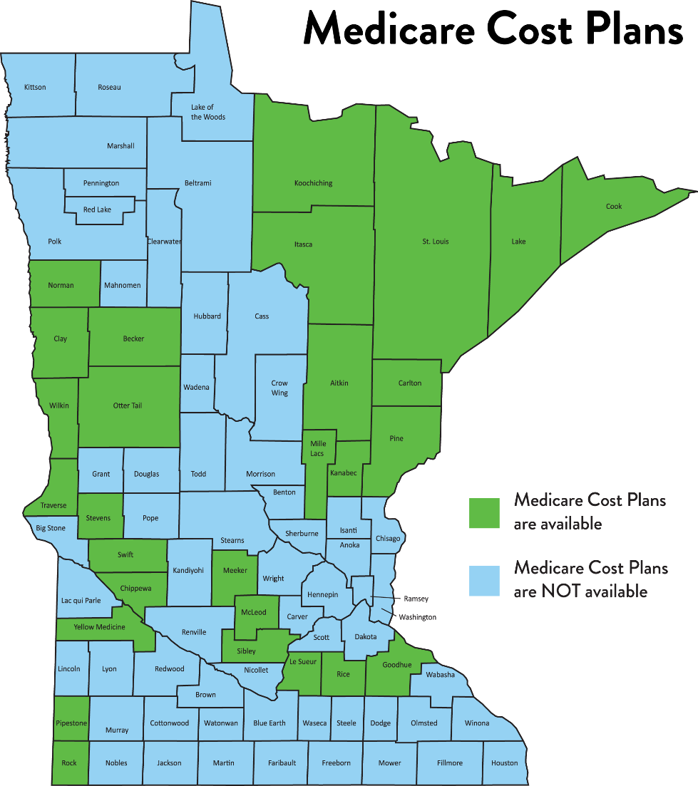
Medicare Cost plans available in more counties
Cost plans are available in 28 counties in Minnesota for 2027
Medicare Cost plans are managed by private insurance companies and combine a managed care plan with Original Medicare.
These are not the same as Medicare Advantage plans.
People with ESRD are not eligible for Cost plans.

Slide 19
New annual Medigap Open Enrollment Periods
Medicare Supplement Insurance, more commonly known as Medigap, is sold by private companies and helps pay some of the out-of-pocket costs that Original Medicare does not cover.
There will be new opportunities for people to purchase or change Medigap coverage in 2027.
  Eligible people ages 65 to 70 who have not previously had or applied for Medigap coverage can purchase a Medigap policy without medical underwriting.
  Eligible people can also switch Medigap insurers or policies without medical underwriting during this period.
  This is a significant change in Minnesota because insurance companies generally can use health questions to decide whether to accept an applicant outside protected enrollment periods.
Medicare Open Enrollment does not automatically give everyone the right to buy any Medigap policy without medical underwriting. Check the person's age, previous Medigap coverage and eligibility before explaining their options.
Notes:
Major change in MN.
For the first time ever, MN will have open enrollment periods for Medigap.
These Medigap Open Enrollment periods are not the same as Medicare Advantage Open Enrollment and are not the same as Medigap Guaranteed Issue Rights.

Slide 20
Guaranteed issue rights versus open enrollment
There are two ways people can purchase a Medigap policy without answering health questions. The main difference is why they qualify and when they can enroll.
Rule | NEW Medigap Open Enrollment Period | Guaranteed issue rights
Qualification | Generally, people ages 65 through 70 who have not previously had or applied for Medigap coverage and meet the law's requirements. | The first six (6) months after you or your spouse enrolls in Part B.
Enrollment dates | During the annual period established by Minnesota law. 10/15-12/7 and 1/1-3/31 | During a limited window tied to the qualifying event.
Underwriting | No, if the person meets the annual enrollment requirements. | No, if the person qualifies for guaranteed issue rights and applies within the required period.
Surcharge | Will apply | No
Notes:
Guaranteed Issue Rights
Applies to the first 6 months after enrolling in Part B
No need to enroll in Part B if you or your spouse continues to work and receive group health insurance benefits beyond age 65. Must work for employer with at least 20 employees
Can purchase a Basic Medigap policy with optional, limited riders that available in Minnesota
No underwriting (health screening); no pre-existing conditions, coverage begins immediately
Medigap Open Enrollment Period
Must be age 65-70 and never purchased or tried to purchase a Medigap policy
Must pay surcharge added to premium based on what age the policy was purchased
Cannot have Medicare Advantage Plan
Enrollment periods: 10/1-12/7 and 1/1-3/31

Slide 21
Medigap Open Enrollment Periods dates
There are two Medigap Open Enrollment Periods.
When you purchase a policy will determine coverage starting date.
While these dates align with the annual Medicare Advantage annual enrollment period and the Medicare Advantage open enrollment period, these are separate enrollment periods.
Enrollment period | Coverage begins
October 15 – December 7 | January 1
January 1 – March 31 | The first day of the following month

Slide 22
Medigap premium surcharge
Minnesota's new annual Medigap open enrollment period comes with a premium surcharge for some people.
The surcharge applies to eligible people who are 65 through 70 years old, who purchase a policy during the annual open enrollment period instead of their initial six-month Medigap enrollment period.
The surcharge applies to the person's premium for as long as they keep the policy. It is added to any regular premium increases.
The year you enroll | Premium surcharge
2026 | 15%
2027 | 20%
2028 | 25%
2029 | 30%
2030 or after | 35%

Slide 23
What you should do during Medicare Open Enrollment
There are certain steps you do every year to make sure you have the Medicare coverage that best fits your needs.
Step 1: Read the Annual Notice of Change (ANOC)
Step 2: Review your current coverage
Step 3: Gather personal information
Step 4: Compare available plans
Step 5: Make a decision and confirm enrollment
Notes:
Medicare Open Enrollment happens every year from October 15 - December 7.
Changes made during this time generally take effect on January 1.
If you cannot locate your ANOC, call your plan and ask them to send you another copy. This document is too important to not have for your review.
Comparison of Medicare Advantage, Medicare Cost and Medicare Part D plans are all done via the Medicare Plan Finder tool found at www.Medicare.gov

Slide 24
Step 1: Read the Annual Notice of Change
If you’re currently on a Medicare plan, each fall you’ll receive an ANOC, which outlines any changes in coverage, costs, etc. that will be effective in January.
  Use the information to help you decide if you should make a plan change.
If you can’t find your ANOC, call your plan to get a copy.

Slide 25
Step 2: Review your current coverage
Is your current plan available next year or is your plan coverage ending?
During Medicare Open Enrollment you can change how you get Medicare coverage.
  Switch from Original Medicare to a Medicare Advantage plan or from a Medicare Advantage Plan to Original Medicare
  Join, drop or switch to another Medicare Advantage plan, with or without drug coverage
  Enroll in or switch to another Medicare Cost plan, with or without drug coverage.
    Enrollment in Cost plans without Rx is available throughout the year.
  Join, drop or switch to another Medicare drug plan if you’re in Original Medicare

Slide 26
Step 3: Gather personal information
Before you can compare your Medicare options, you will need to gather your personal medical information.
Make a list of:
  Current Medicare and insurance cards
  Prescription medications and dosage amounts
  Doctors, specialists and hospitals
  Preferred pharmacies
  Expected health care needs for the coming year

Slide 27
Step 4: Compare available plans
Use the Medicare Plan Finder at Medicare.gov to review the plans available in your ZIP Code and to enroll in a plan.
The Medicare Plan Finder will allow you to compare:
  Monthly premiums and yearly out-of-pocket costs
  Prescription coverage and estimated drug costs
  Doctor, hospital and pharmacy networks
  Benefits and coverage rules
  Quality and customer service ratings from current plan members
You can also chat with Medicare staff while using the Medicare Plan Finder

Slide 28
Compare available options: Medicare options
Option 1: Original Medicare
Option 2: Medicare Health plans
Original Medicare
Part A
Part B
Advantage plan
Part A
Part B
Part D*
Additional benefits
Cost plan
Part A
Part B
Part D**
Additional benefits
+
Optional coverage
Medigap policy
Part D
+
Optional coverage
Part D
  * Most Advantage plans require you to get Part D through the plan.
** You can choose to get Part D through a Cost plan or a Part D stand-alone plan.

Slide 29
Step 5: Make a decision and confirm enrollment
If you need to change your Medicare coverage, you must submit the enrollment request by December 7.
You can enroll by:
  Using Medicare.gov (with or without extra help from Minnesota Aging Pathways)
  Call 1-800-Medicare
  Using an agent or broker
  Calling the insurance plan directly
Keep the enrollment verification number from Medicare.gov after you enrolled in a plan.
Keep confirmation details and review the new plan's materials when they arrive by mail.

Slide 30
What if my Medicare Advantage plan is ending?
You will receive a letter from your insurance company notifying you that your plan won’t be offered in the following year.
You will need to choose how you want to get your health and prescription drug coverage for next year.
  Option 1: You can join another Medicare health plan available in your ZIP Code.
  Option 2: You can change to Original Medicare, join a separate Part D plan. You can also buy a Medigap policy.
If you don’t take action before December 31, 2026, you will lose your prescription drug coverage and only be covered by Original Medicare starting January 1. Special enrollment period may apply.
Notes:
If your Part D prescription drug plan is ending, you may be automatically enrolled in a new plan. The new plan may have different drug coverage and may or may not be a benchmark plan. A Part D benchmark plan is a prescription drug plan that has a monthly premium at or below a specific regional dollar limit set each year by the CMS.

Slide 31
What if you don’t make a change?
If you’re happy with your current plan and it is available next year, you will stay with your current plan, but it may have different out-of-pocket costs and provider networks, and benefit and rule changes will apply.
If your plan is ending, you will receive a letter from your insurance company. This will detail what will happen to your coverage next year.
  You may be automatically enrolled in a different plan by your insurance company, or
  You may lose your prescription drug coverage and only be covered by Original Medicare.
If you miss the December 7 deadline, other enrollment opportunities may apply depending on your circumstances. The Medicare Advantage Open Enrollment Period runs from January 1 - March 31, but it has different rules and is not a general extension of fall Open Enrollment.

Slide 32
During open enrollment, beware of marketing fraud
Watch out for people who:
  Pressure you to join their plan.
  Say they represent Medicare or give you a service for free.
  Call your home without permission.
  Say that you’ll lose your Medicare benefits if you don’t sign up for their plan.
  Require you to provide contact information at a plan event.
Call Minnesota Aging Pathways at 800-333-2433 if you have been a fraud or scam victim
Notes:
CMS made several changes to Medicare Advantage and Medicare drug plan marketing rules for 2027.
Notice of Availability requirement removed
Plans no longer need to send a separate notice about language assistance and other communication support. Another federal requirement already covers this notice.
More flexibility for outreach
Plans can now:
Hold marketing events right after educational events at the same location, as long as attendees know they can leave.
Schedule marketing appointments any time after a person completes a Scope of Appointment (SOA) form.
Collect SOA forms at educational events.
Fewer advertising requirements
Plans no longer need to include supporting documents with claims such as “best” or “most.” However, CMS may still ask for proof to support these claims.
Updated marketing disclaimer
Plans must now give the Third-Party Marketing Organization (TPMO) disclaimer verbally before discussing benefits. They no longer need to list State Health Insurance Assistance Programs (SHIPs) as a resource in the disclaimer.
Midyear benefits notice removed
Plans no longer need to notify members between June 30 and July 31 about supplemental benefits they have not used.
Shorter call recording retention
Plans must keep sales and marketing call recordings for six years instead of 10. They may use transcripts instead of recordings for years four through six.

Slide 33


Need help or don’t have a computer
Medicare
800-MEDICARE (800-633-4227)
  24 hours a day, seven days a week.
Medicare.gov
Minnesota Aging Pathways
800-333-2433
  Monday-Friday, 8:00 a.m. - 4:30 p.m.
mn.gov/aging-pathways

Slide 34
Questions
Notes:
Are there any questions?

Slide 35

ACL Medicare satisfaction survey
This three-page survey from the ACL should take less than five minutes to complete.
Your responses are completely anonymous and will help improve programs and services.
www.surveymonkey.com/r/ACLED
Notes:
This survey was approved by the United States Government's Office of Management and Budget, Control Number 0985-0056. If you have any questions about this survey, please contact katherine.glendening@acl.hhs.gov.

Slide 36
Presenter:
Thank You
aging.pathways@state.mn.us
Notes:
Thank you very much!

